Slide 1
Edge and Corner Detection

Slide 2
Basics
Edge pixels are those at which image intensity changes abruptly.
Edge segments or edges are sets of connected edge pixels.

Slide 3
Digital derivatives: first versus second
Along a ramp (i.e. intensity change with constant slope), first derivative is a non-zero constant.
Second derivative is zero along the ramp, except at the start and end!
Second derivative is preferable for image sharpening! Many edges in images are ramp-like, in which case first derivative will give thick edges (undesirable), whereas second derivative gives thin edges two pixels wide (desirable).
Second derivative changes sign midway at a step edge (zero crossing property).

Slide 4
Digital derivatives: first versus second
At roof edges, second derivative gives stronger response than first derivative (i.e. has larger magnitude) – except if both parts of the roof were at 45 degrees, where both will have equal response.
At isolated points, second derivative gives stronger response than first derivative
A rotationally invariant second-derivative operator is used for edge detection: the Laplacian, in fact zero-crossings of a Laplacian.

Slide 5
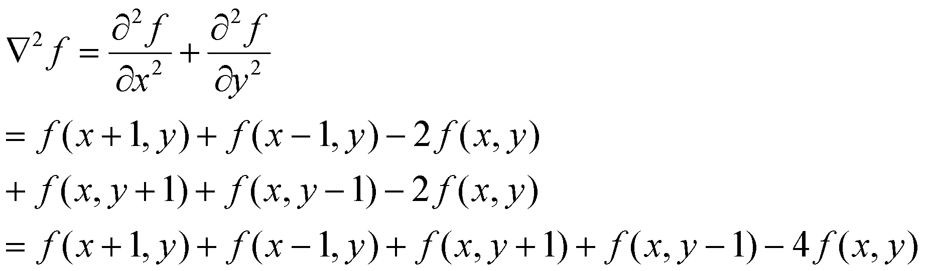
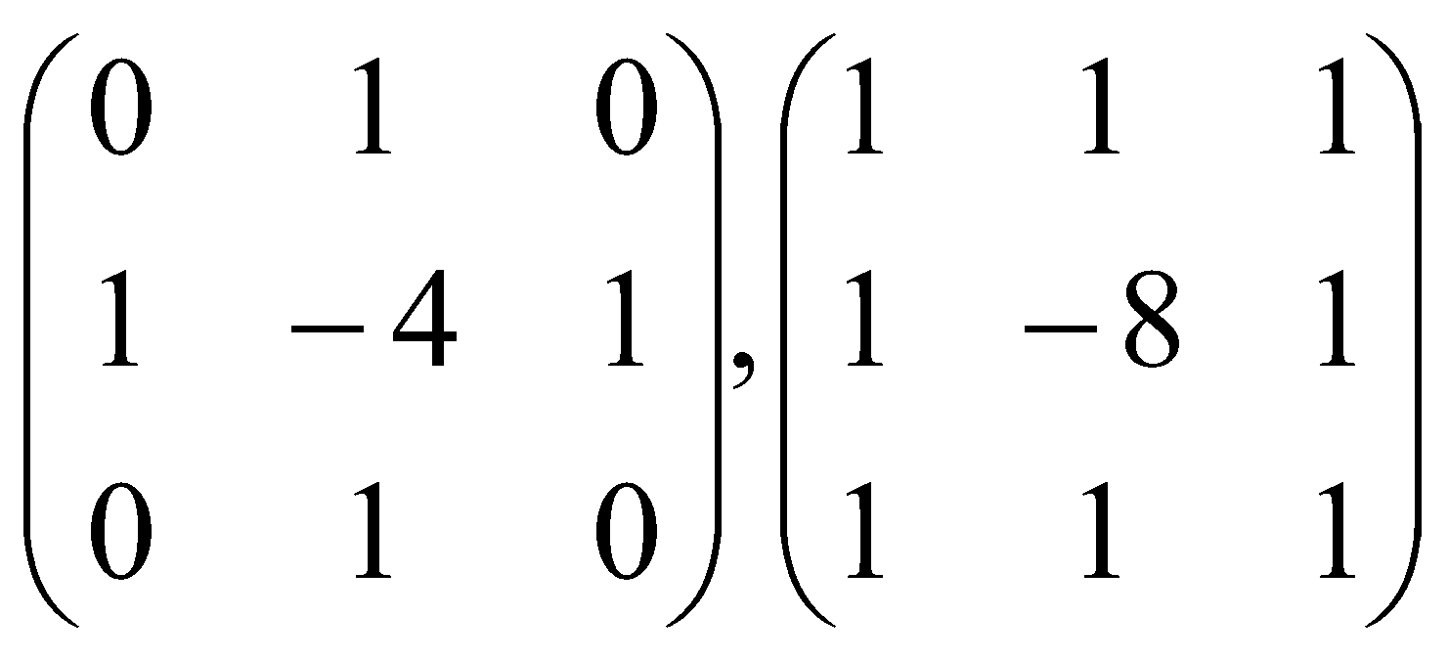
Laplacian of an image
Rotationally symmetric operator (in the continuous domain)
Laplacian operators: second operator is obtained by adding second derivatives along both the diagonals, to the first operator

Slide 6
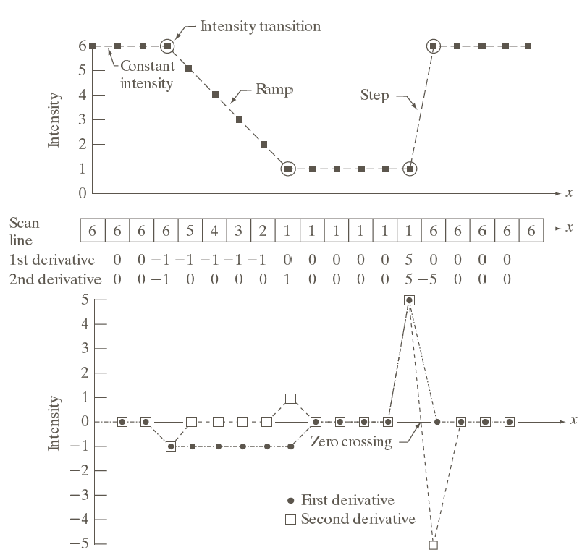
Intensity discontinuity, also called step edge
From book by Gonzalez and Woods

Slide 7
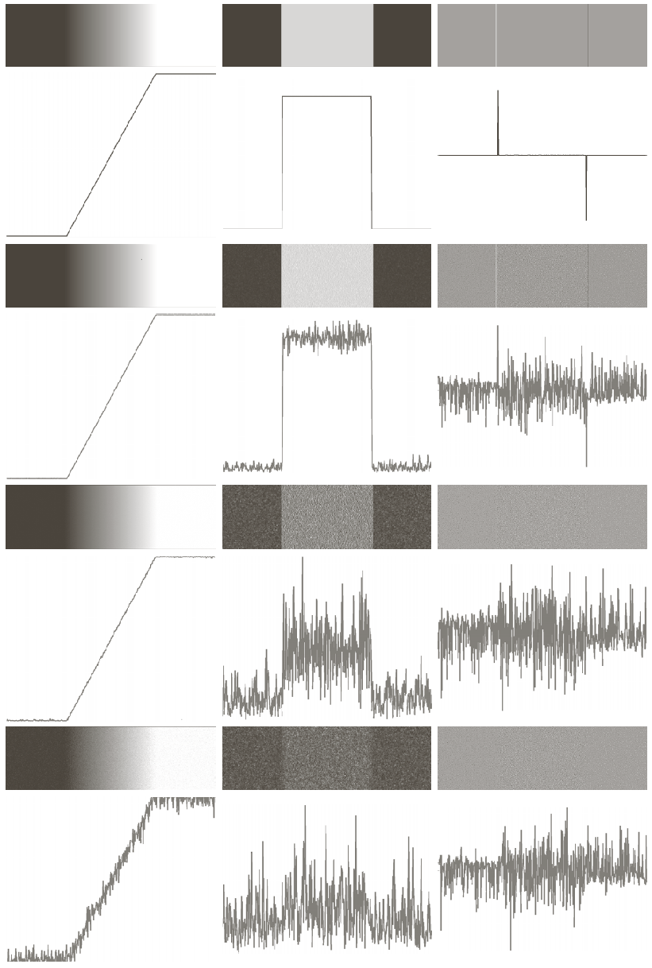
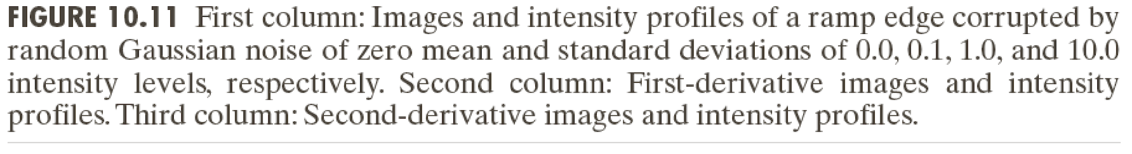
Edge detection under noise
First and second derivatives are very sensitive to noise!
Left to right in each row: original image, first derivative, second derivative
In any column: increase in noise level

Slide 8
Steps in robust edge detection
Image smoothing to reduce noise: because first and second derivatives are noisy
Actual detection of edge points (may produce thick or disconnected edges)
Pruning or linking of the edge points

Slide 9
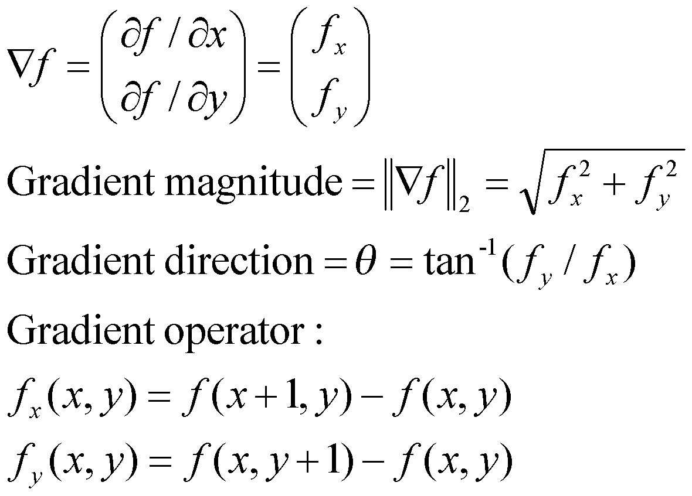
Edge detection: image gradient
An image gradient is defined as follows:

Slide 10
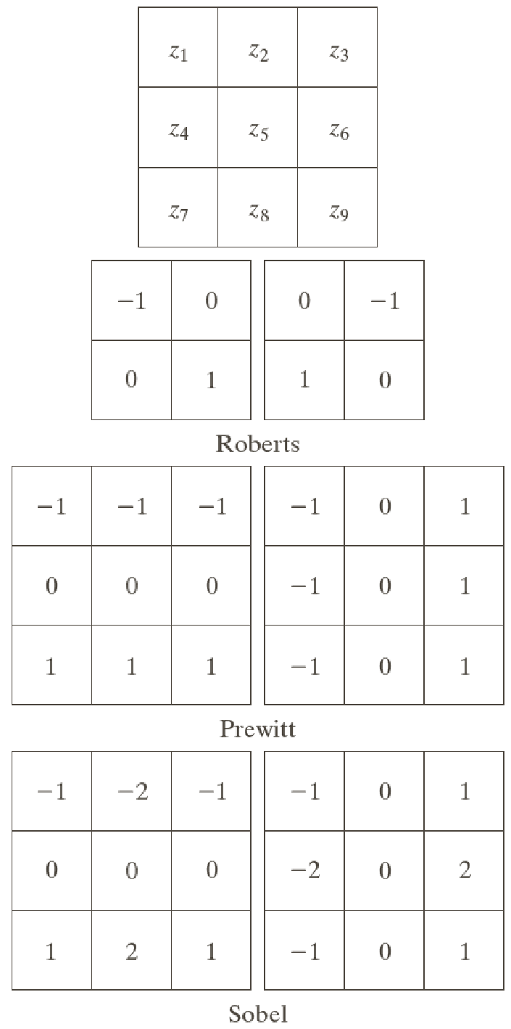
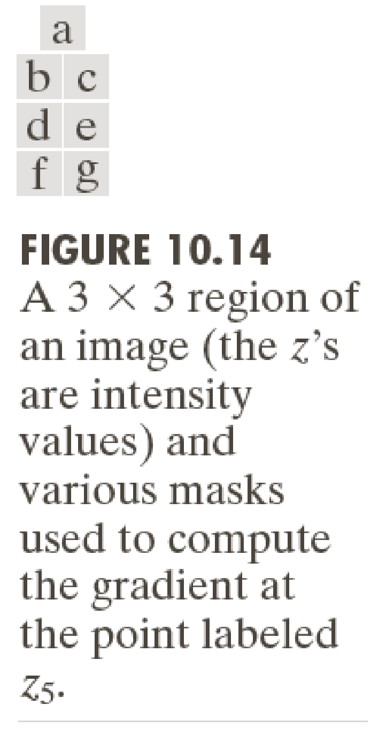
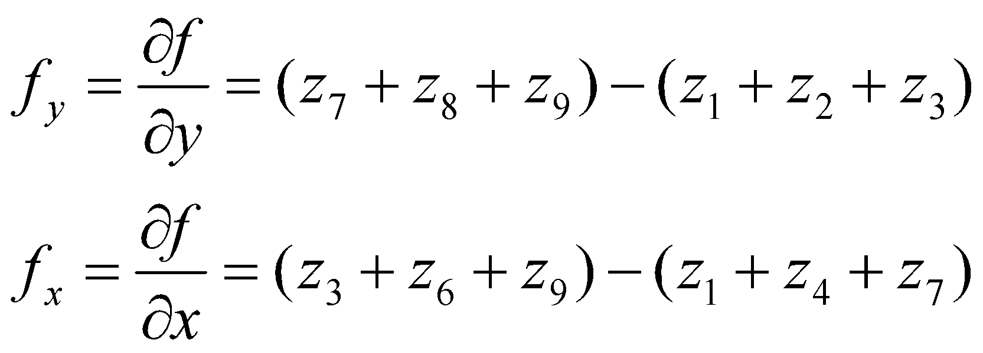
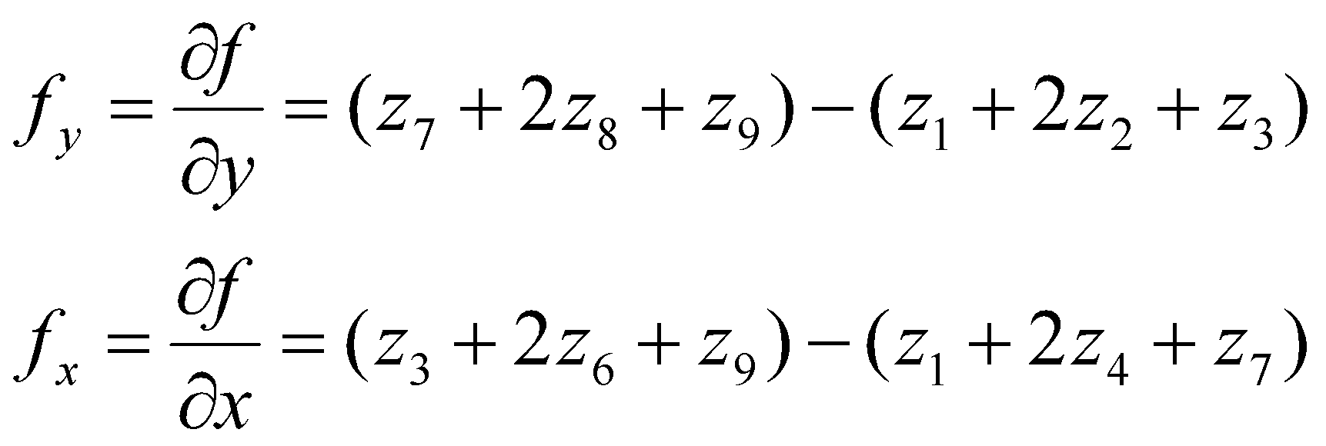
Robust edge operators
These operators: Prewitt and Sobel perform some smoothing prior to difference computation, and hence are more robust than the simple finite differences from the previous slide.

Slide 11
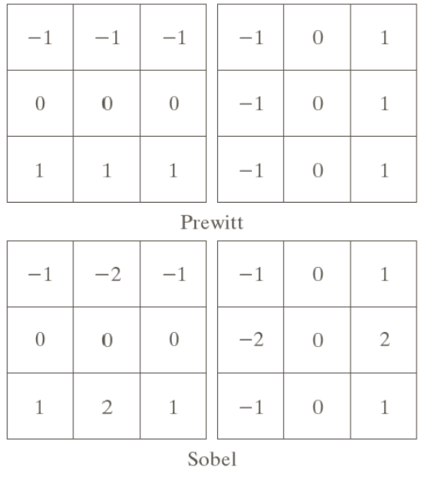
Prewitt and Sobel
Apply the differencing mask [-1 0 1]^{T} and then apply the smoothing mask [1 1 1] on the result. This is equivalent to applying the first Prewitt mask (i.e. for f_{y}).
For the Prewitt operator for f_{x}, apply [-1 0 1] and then [1 1 1]^{T}.
Apply the differencing mask [-1 0 1]^{T} and then apply the smoothing mask [1 2 1] on the result. This is equivalent to applying the first Sobel mask (i.e. for f_{y}).
For the Sobel operator for f_{x}, apply [-1 0 1] and then [1 2 1]^{T}.

Slide 12
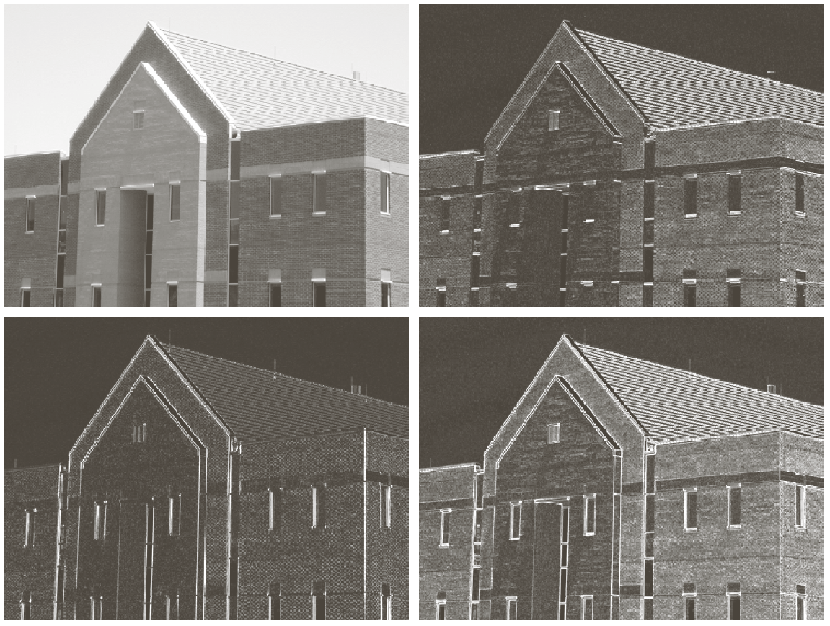
Edges with Sobel Mask
Original image
Derivatives in y direction: f_{y}
Derivatives in x direction: f_{x}
| f_{x} | + |f_{y}|

Slide 13
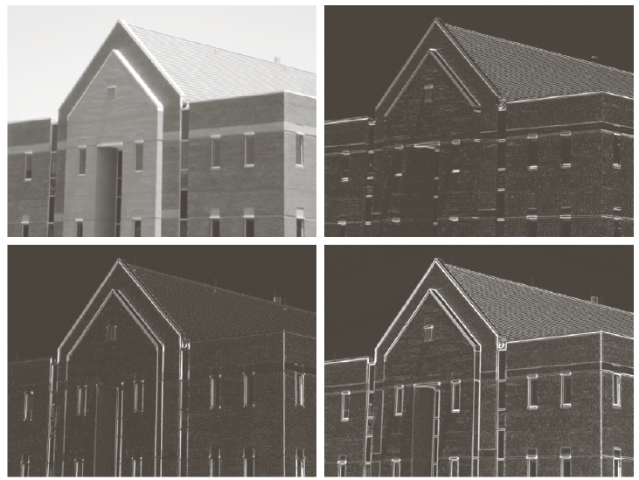
Edges with 5 x 5 averaging followed by Sobel Mask
Original image
Derivatives in y direction: f_{y}
Derivatives in x direction: f_{x}
|f_{x} | + |f_{y}|
Notice: finer details removed

Slide 14
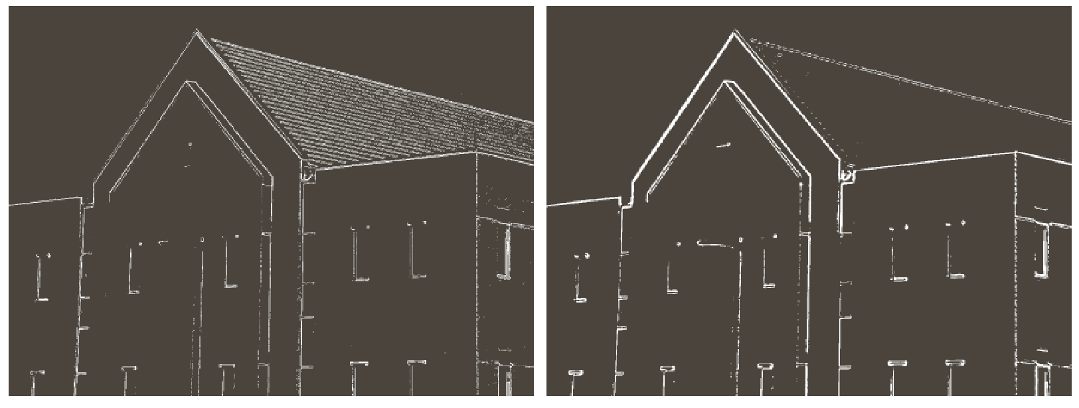
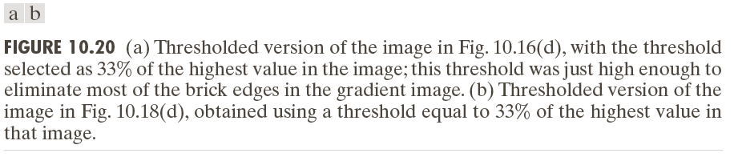
Edge map after Thresholding the earlier map.

Slide 15
Marr-Hildreth edge detector
Principled approach to combined edge detection and image smoothing
An edge operator should satisfy two criteria:
Notion of scale in edge detection (operators of different sizes)
Differential operator to compute first or second derivatives of the intensity
Uses the Laplacian of Gaussian operator on an image satisfies both criteria

Slide 16
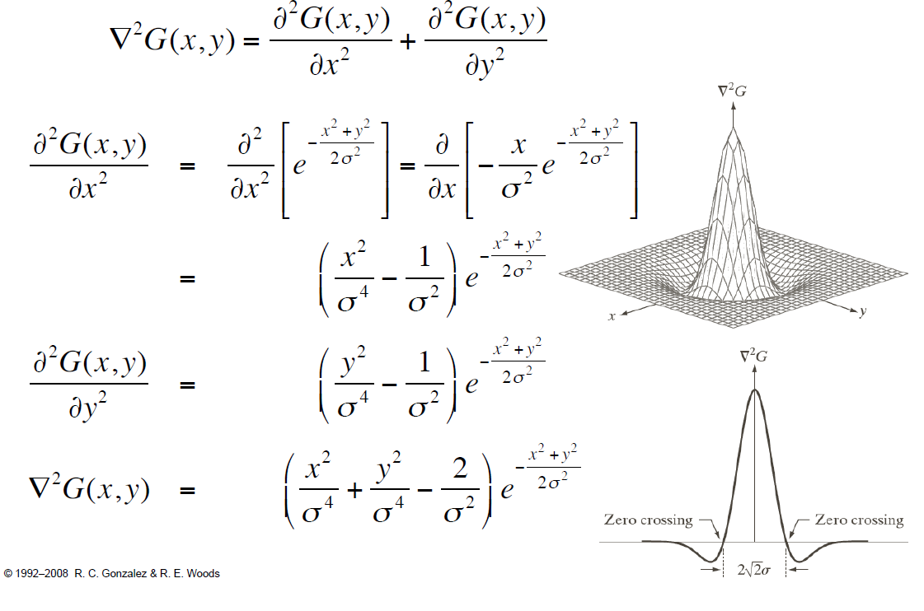
Laplacian of Gaussian (LoG or Mexican hat)

Slide 17
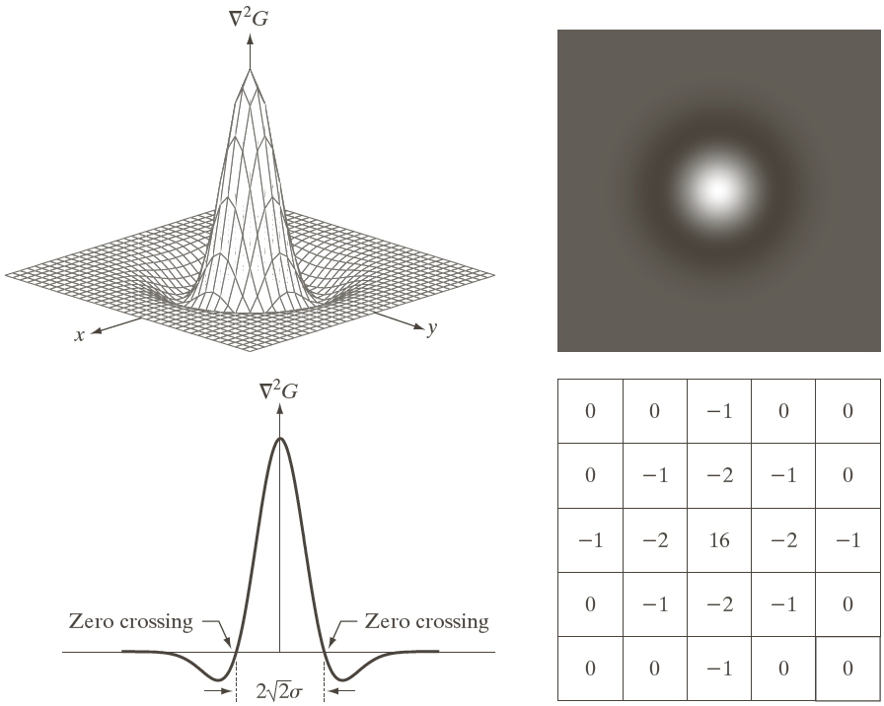
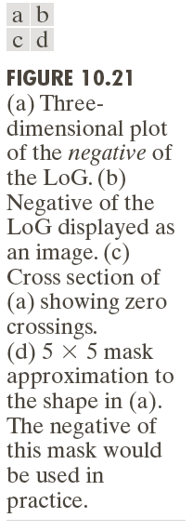

Slide 18
Why LoG for edge detection?
Remember: we are interested in zero-crossings of the second derivative!
We want the second derivative operator to be rotationally invariant. The Laplacian is the simplest (though not the only) such operator.
The Gaussian is a low-pass filter, which blurs structures with intensity difference smaller than σ.
Gaussian is smooth in spatial and frequency domains.

Slide 19
Using LoG for edge detection
(1) Convolve the image with the LoG operator, i.e.:
(2) Find the zero-crossings in the resultant image.

Slide 20
Implementing the convolution
Use an n x n mask, created by sampling the formula for LoG on a discrete Cartesian crid of size n x n.
How to choose n? Depends on σ: n should be >= 6σ, because more than 99% of the volume underneath a 2D Gaussian lies between μ-3σ and μ+3σ.

Slide 21
Finding zero-crossings
Look at a 3 x 3 window around a pixel.
There exists a zero-crossing at that pixel if the signs of at least one pair of opposing neighbors (top & bottom, left & right, top-left & right-bottom, top-right & left-bottom) differ and the difference in their values must exceed a threshold p.
(x,y)

Slide 22
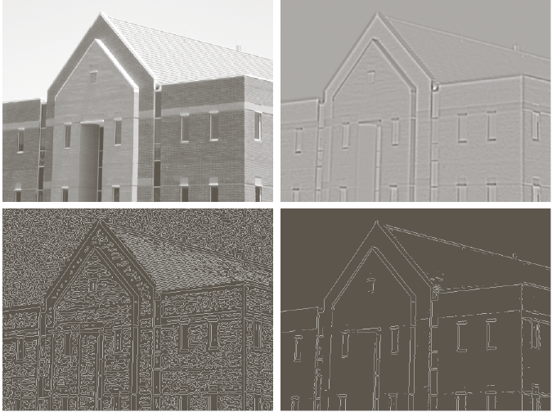
σ = 4,
n = 25
Convolution with LoG
Zero-crossings
Zero-crossings + thresholding

Slide 23
Some properties of the Marr-Hildreth Edge Detector
Detected edges are 1-pixel in thickness
Can be used for different sigma values, keeping only those edge points that are common to multiple scales

Slide 24
Canny Edge Detector: using 1st derivatives
Three aims/objectives:
Low error (no spurious responses due to noise)
Well-localized edge points
Single pixel wide edges
Canny’s detector was formulated by analyzing step edges in 1D under zero-mean i.i.d. Gaussian noise, and expressing the preceding three criteria mathematically and deriving an (approximate) operator that obeys all criteria.

Slide 25
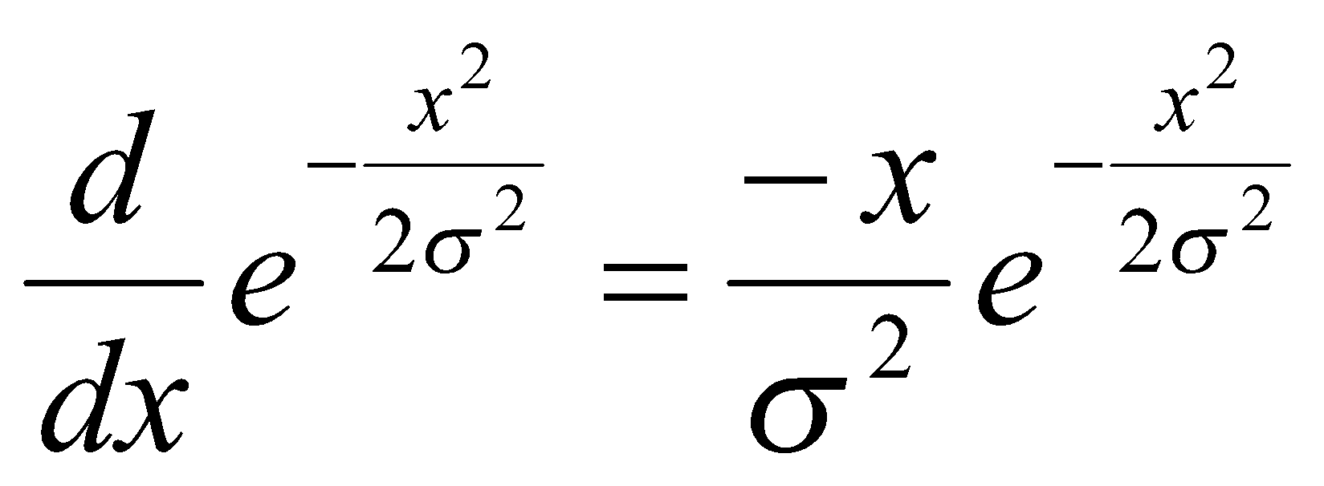
Canny’s Edge Detector
In 1D, the approximate operator was the first derivative of the Gaussian:
In 2D, the approximate operator was the first derivative of the Gaussian in the direction of the local image gradient (i.e. perpendicular to the edge).
But the true gradient is not known, so we first smooth the image with a 2D Gaussian and then use its gradient magnitude and direction.

Slide 26
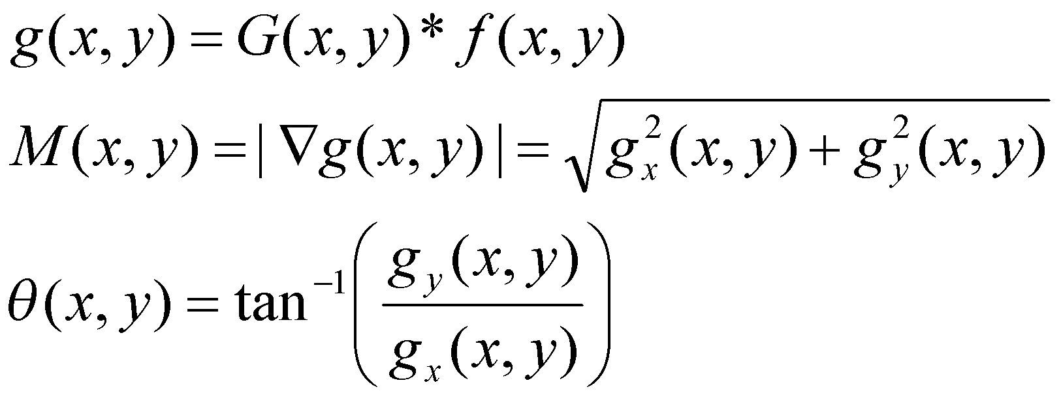
Canny’s Edge Detector
Gradient magnitude and direction:
M(x,y) contains wide ridges along the true edges of the image.
Though the maximum values are along the edge, those values don’t immediately fall off to 0 on either side of the edge.
Recall ramp edges.

Slide 27
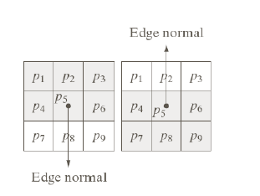
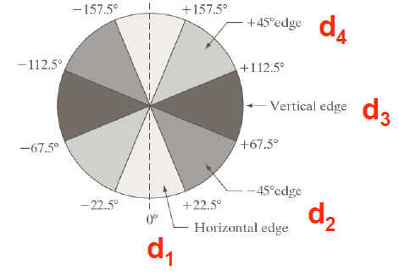
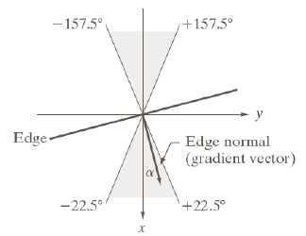
Canny edge detector
This requires us to perform a thinning operation – called as non-maximal suppression (i.e. we set to zero those values of M(x,y) which are likely to NOT be local maxima).

Slide 28
Canny edge detector
Consider the four quantized directions shown on the previous slide. Pick the direction d_{k}, which is closest to ϴ(x,y).
If M(x,y) is less than either of its two neighbors along the direction d_{k}, then set it to 0 (i.e. suppress the non-maximum), otherwise we leave it as is.
After this processing, M(x,y) is the non-maximal suppressed image.

Slide 29
Canny Edge Detector
The (thinned) edge map so far may still contain some false positives. This is taken care of (to some extent) by hysteresis thresholding.
This uses a low-threshold TL and a high threshold TH.
We keep only those pixels for which
-M(x,y) > TH, OR
-M(x,y) > TL AND (x,y) is a neighbor of at least one pixel with M(x,y) > TH.
The 8 neighbors of pixel (x,y)
(x,y)

Slide 30
Summary: Canny Edge detector
(1) Convolve the image with a Gaussian Filter. Compute the gradient magnitudes and orientations.
(2) Perform non-maximal suppression.
(3) Perform hysteresis thresholding.

Slide 31
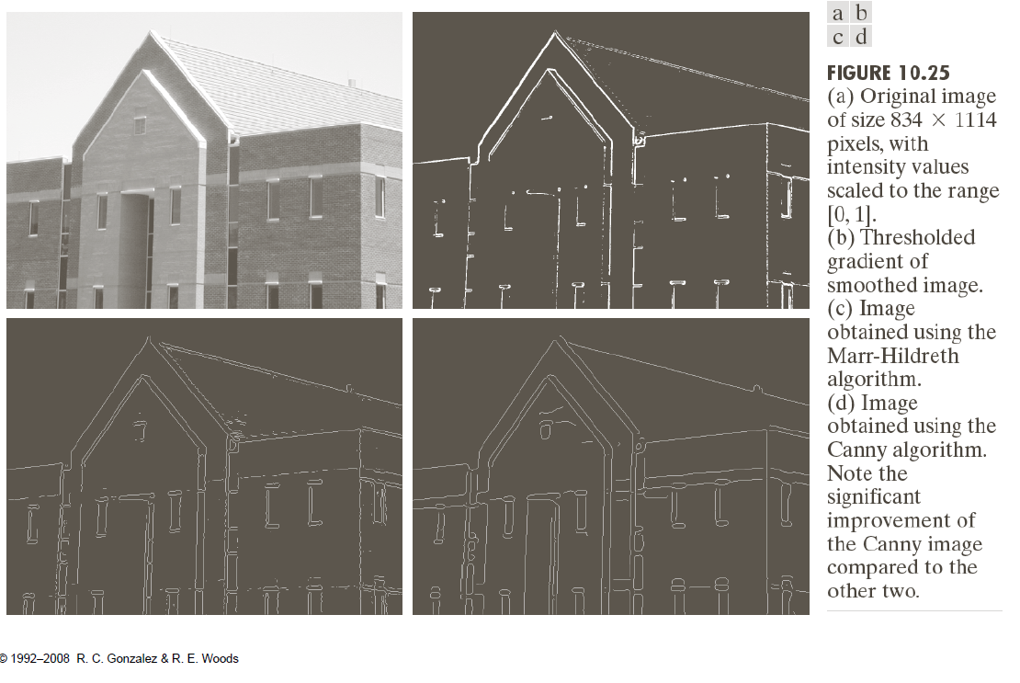

Slide 32
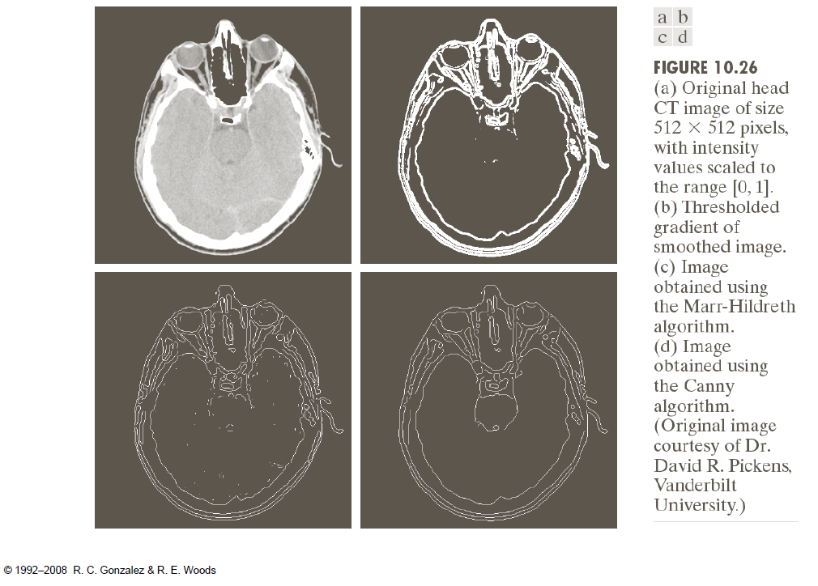

Slide 33
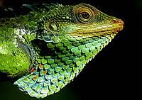
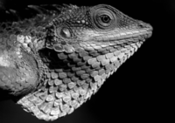
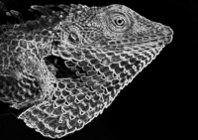
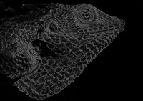

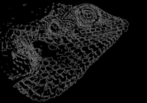
Gaussian filtered (sigma = 1.4, 5 x 5 mask)
Intensity gradients superimposed
https://en.wikipedia.org/wiki/Canny_edge_detector
Non-maximum suppression
Double thresholding (TL = 0.1, TH = 0.3)
After edge-linking (hysteresis)

Slide 34
Corner Detection

Slide 35
Importance of corners
Corners are considered salient feature points.
Useful in many tasks in computer vision and image processing
Example: corresponding control points for image alignment

Slide 36
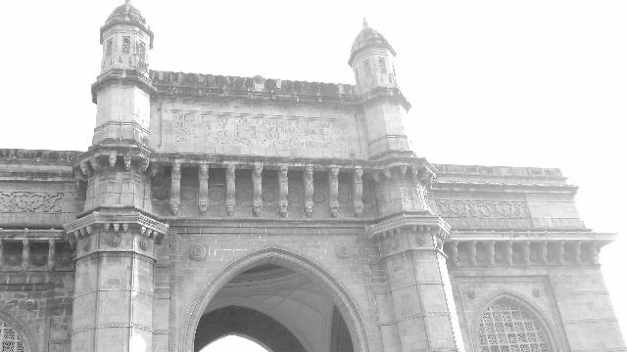
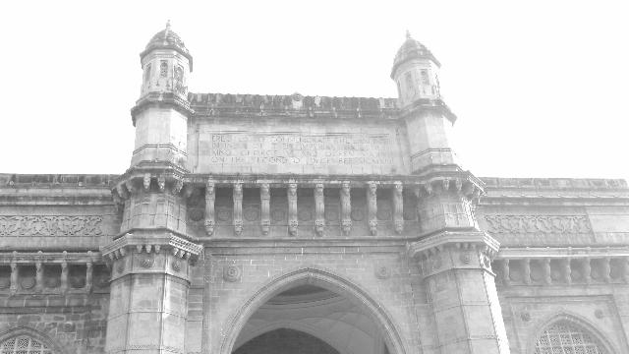

Slide 37
Importance of corners
In some applications, we need to find matching patches.
But some patch matches are easier to find than others.
Each patch is assumed to be centered at a certain point (say (x,y))
The patch encodes information about the local geometry of the image intensities about that point.
See next slide for examples.

Slide 38
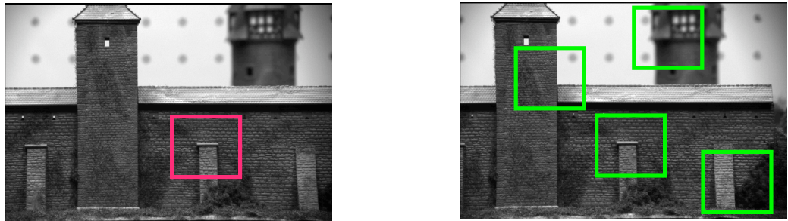
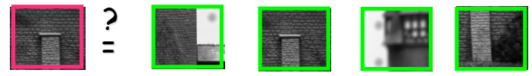
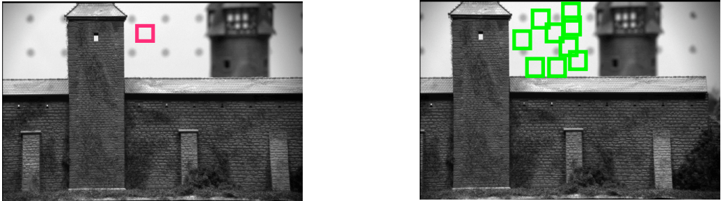

Good patch for matching
Bad patch for matching
http://www.cse.psu.edu/~rtc12/CSE486/lecture06.pdf

Slide 39
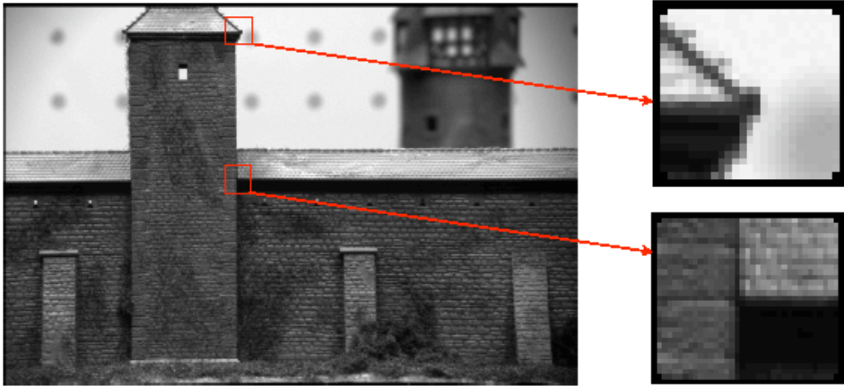
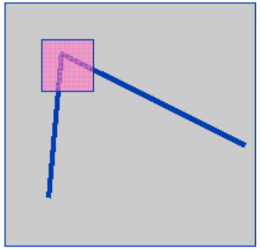
Importance of corners
Good patches should contain corners – large intensity variations in all directions.
Shifting the window in any direction yields large appearance change.
http://www.cse.psu.edu/~rtc12/CSE486/lecture06.pdf

Slide 40
Ambiguity in point matching in flat intensity regions or along edges

Slide 41
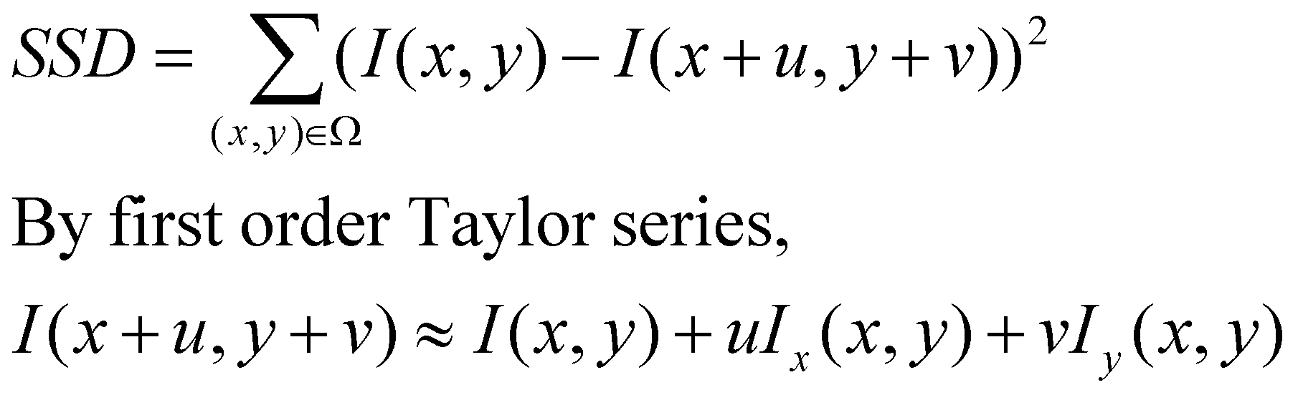
Principle behind Harris corner detector
Consider two patches – one each centered at (x,y) and (x+u,y+v) in two images (patch domain: Ω, typically rectangular, like say 7 x7 or 5 x 5) with u,v being small.
The image have same intensity at physically corresponding locations.
The sum of squared difference (SSD) between their intensities is given as:

Slide 42
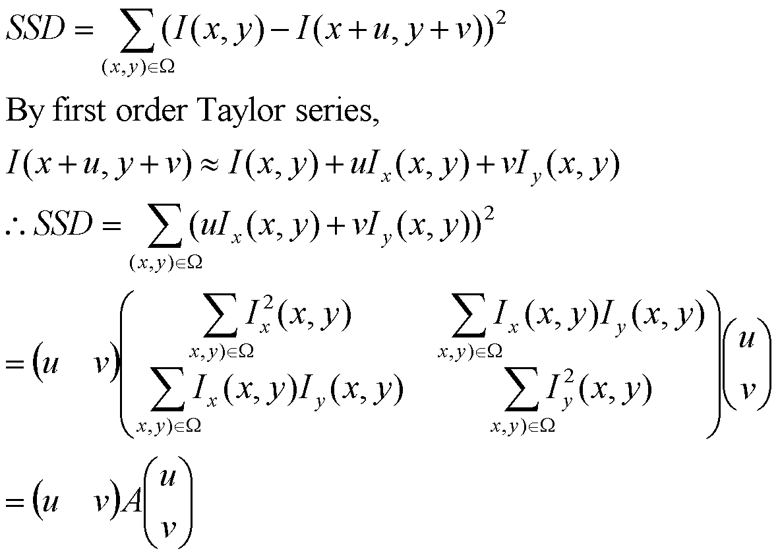
Structure tensor matrix (size 2 x 2)

Slide 43
Principle behind Harris corner detector
The local A matrix on the previous slide is called the structure tensor.
A carries information about local image geometry.
It is always positive semi-definite, i.e. its two eigenvalues are always non-negative.
In locally flat regions, A will be close to a zero matrix and hence both its eigenvalues will be close to 0.

Slide 44
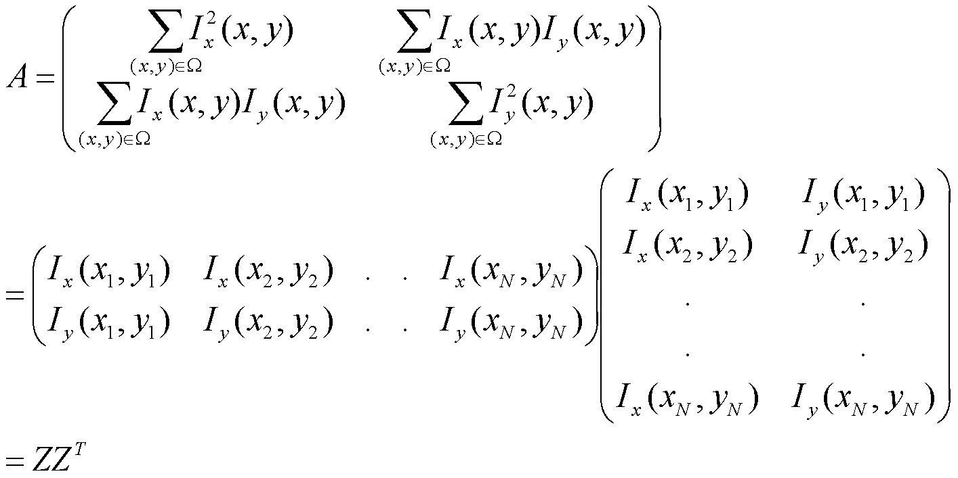
Proof that the structure tensor matrix is positive semi-definite: Method 1
Any matrix that can be written in the form A = ZZ^T is always positive semi-definite (quoting a result from linear algebra)

Slide 45
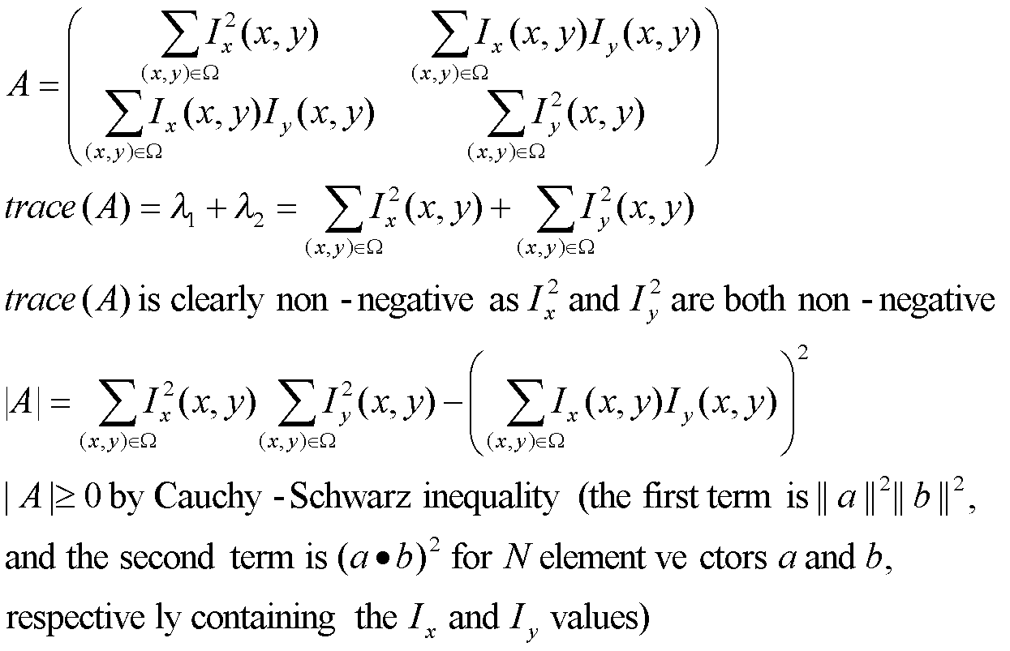
Proof that the structure tensor matrix is positive semi-definite: Method 2

Slide 46
Principle behind Harris corner detector
At a point lying on an edge, only one of the eigenvalues is large (corresponding to the eigenvector that points across the edge) and the other is close to 0 (corresponding to the eigenvector that points along the edge)
At a corner point, both eigenvalues will be large.
We would like the SSD to be large for all non-zero shifts (u,v) so that we can allow for maximum discriminability and easier point matching.

Slide 47
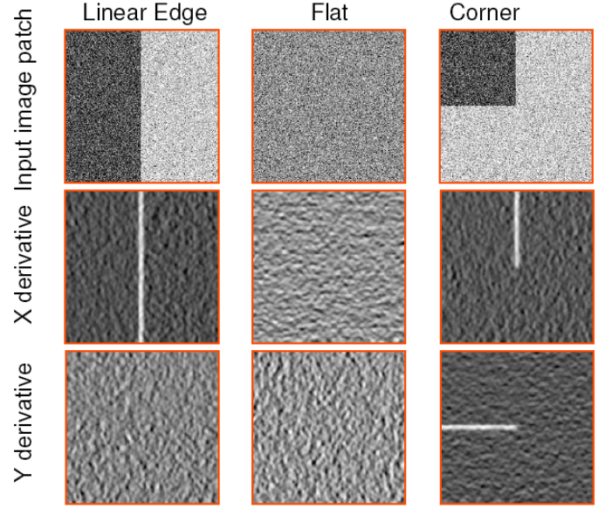
http://www.cse.psu.edu/~rtc12/CSE486/lecture06.pdf

Slide 48
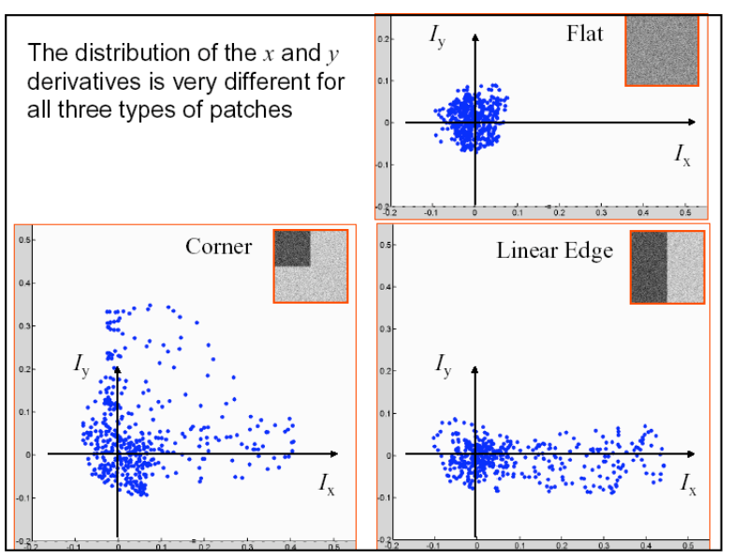
http://www.cse.psu.edu/~rtc12/CSE486/lecture06.pdf

Slide 49
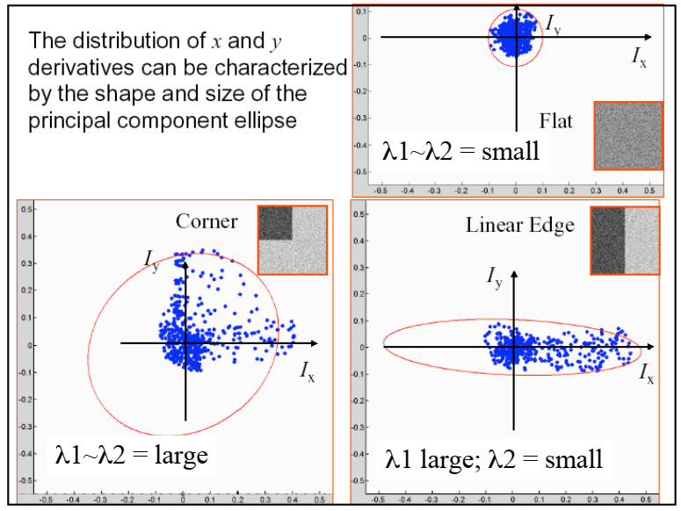
http://www.cse.psu.edu/~rtc12/CSE486/lecture06.pdf

Slide 50
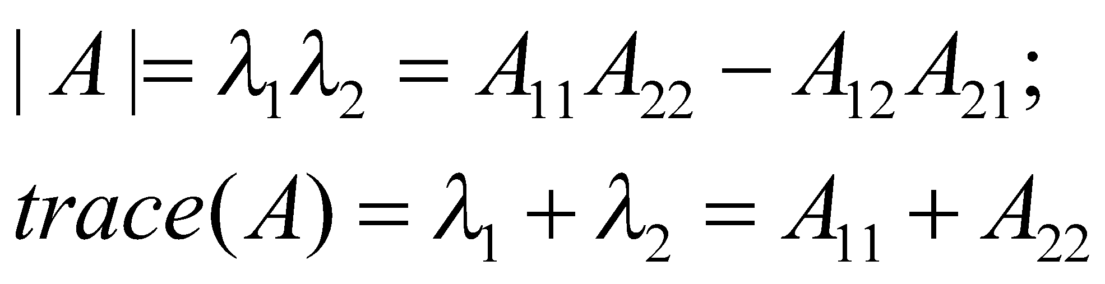
“Corner”-ness measure
We would like both eigenvalues of this matrix to be large.
Corner response or “corner”ness measure:
R_{H} = det(A) – k (trace(A))², k between 0.04 to 0.06
Does not require explicit eigenvalue/eigenvector computation:

Slide 51
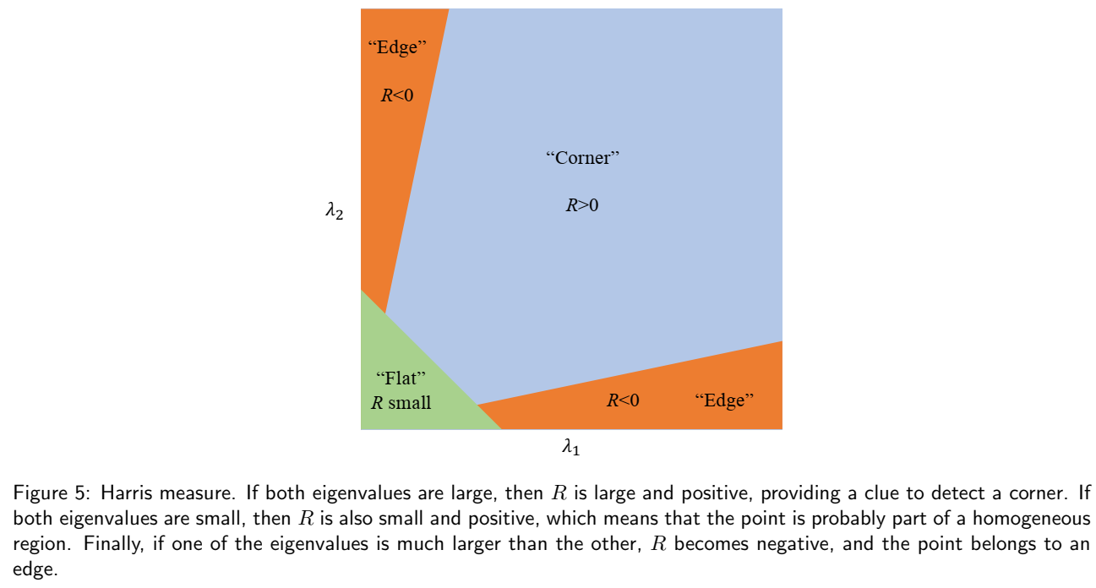
http://www.ipol.im/pub/art/2018/229/article_lr.pdf

Slide 52
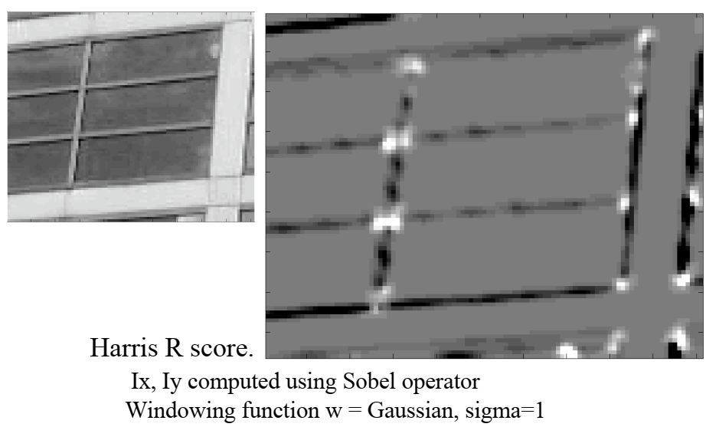

Slide 53
Computing corners
Smooth image I to compute various derivatives
Choose a window size (say 7 x 7) and compute the structure tensor at each pixel, given this window size
Compute the corner-ness measure for each pixel
Perform thresholding or non-maximal suppression to create a corners map.

Slide 54
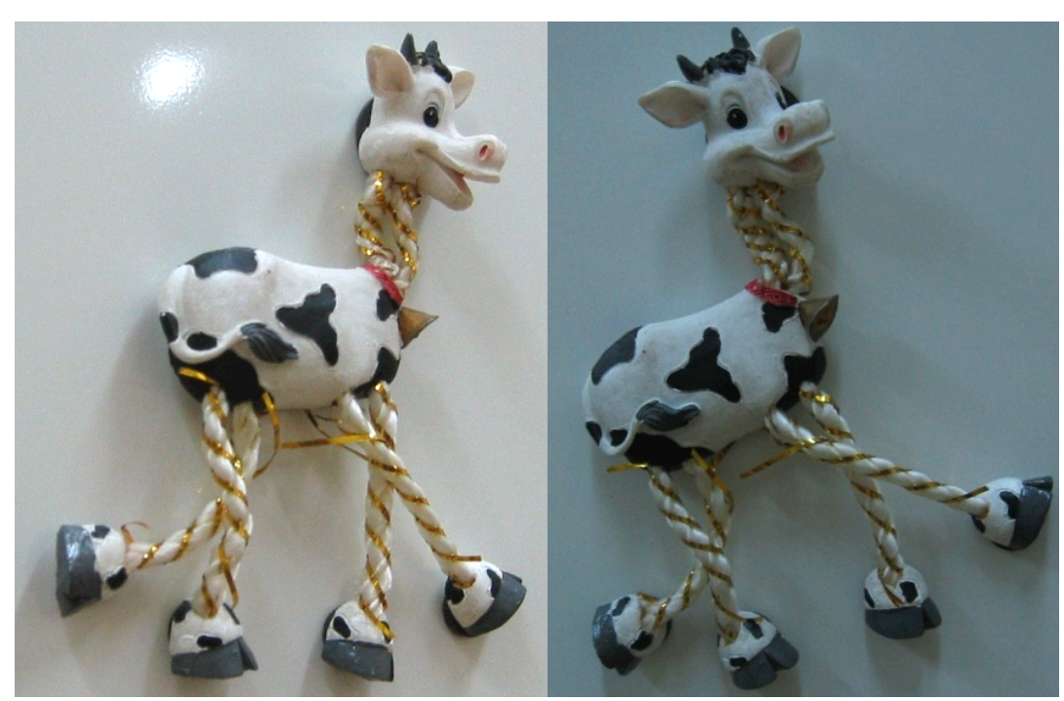

Slide 55
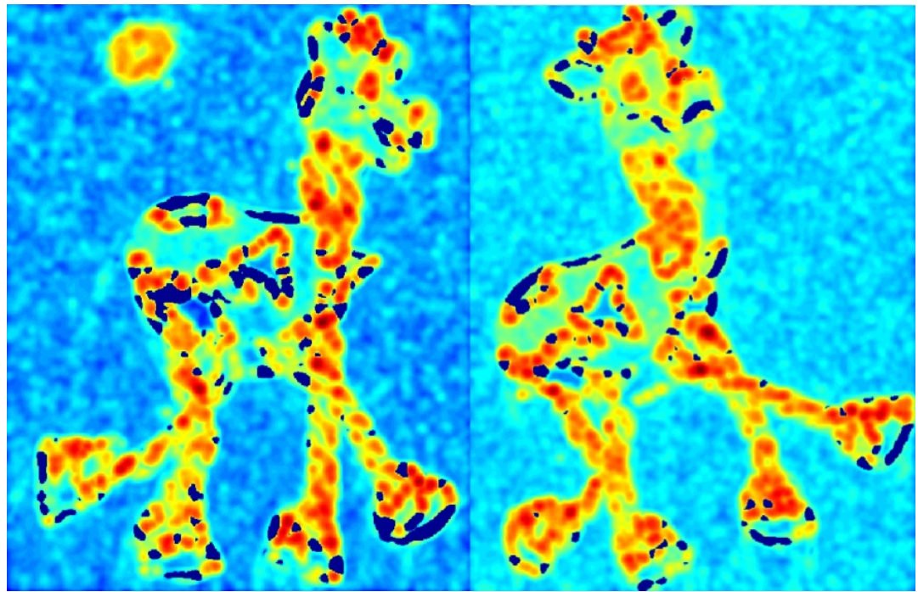

Slide 56


Slide 57


Slide 58


Slide 59
Invariance
The detected corners are invariant under affine intensity change, i.e. image J replaced by aJ + b for scalars a,b.
The corners are also invariant to rotation and translation.

Slide 60

Other measures of corner-ness
Based on just the minimum eigenvalue – declared a corner if the minimum eigenvalue exceeds a threshold
Harmonic mean of eigenvalues

